Slide 1


Developing ASP.NET Core 2.0 Web APIs for your Web and Mobile Apps
Chris Woodruff

Slide 2
Agenda
What we do wrong architecting and development our web APIs
Lets talk about what we need to focus on
What is the Hexagonal Architecture?
How can we use the Hex Architecture in ASP.NET Core Web API?
Wrap up and Questions

Slide 3
What do you and I do wrong?
ASP.NET Core 2.0 Web API and the Hexagonal Architecture

Slide 4
Bad Habits
Calling Data Access functionality (EF Core) from Controllers
Having all code in a single project. Hard to test!
Coupling your Data Access (EF Core) to your project Domain
Do not think about Unit or Integration testing

Slide 5
What does ASP.NET Core help us with?
ASP.NET Core 2.0 Web API and the Hexagonal Architecture

Slide 6
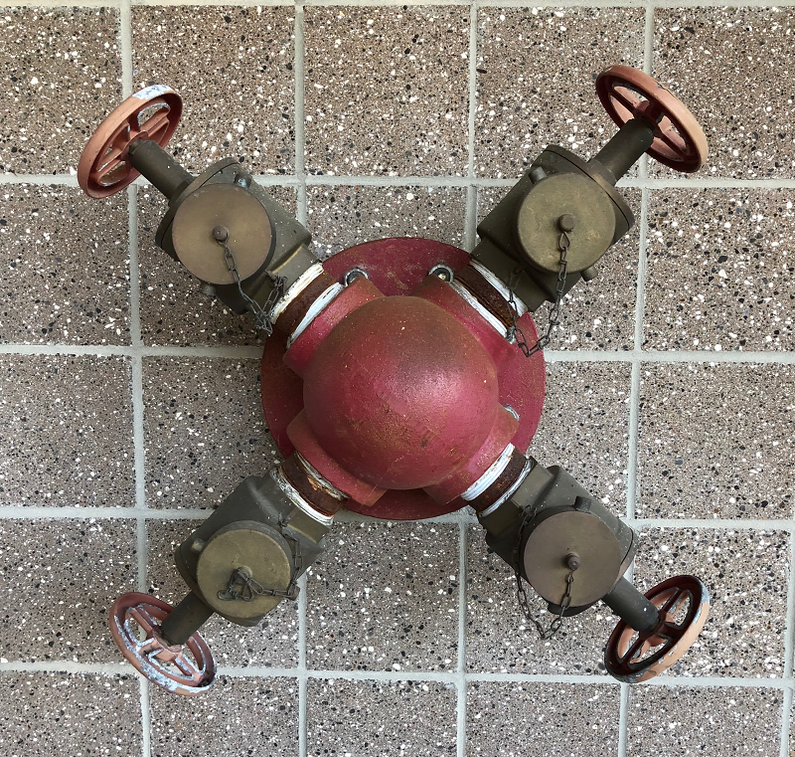
What is the Hexagonal Architecture?

Slide 7
Hex Architecture/Ports & Adapter Pattern
Allows a solution to be driven by users, programs or test equally
All segments of the architecture can be tested in isolation
Have the business logic driven from non-APIs if needed without issues.

Slide 8
API
Domain
Data
Test

Slide 9
How I build my API’s

Slide 10
API Layer
Like the UI of an ASP.NET MVC (or any web platform and pattern), the API endpoints should not know about the Domain knowledge or Data Access
Should interact with ViewModels to ensure the greatest flexibility

Slide 11
Domain Layer
Contains both my Entity models and my ViewModels for the solution.
Contains all my interfaces for Data Retrieval so I can keep a well define standard for my data access.
Allows me to use Dependency Injection for Repositories
Think of the Domain Layer as the Supervisor!

Slide 12
Data Layer
Where all the heavy data lifting happens
I have everything defined based on Interfaces from the Domain Layer
I use Entity Framework Core 2.0 but I can use anything that is .NET Standard 2.0
I also Mock up a data layer for testing

Slide 13
Tests
I have 2 sets of tests: Integration and Unit
Integration for API endpoint testing and Controllers
Unit Testing to cover the Repositories

Slide 14
Now with the Demos!
ASP.NET Core 2.0 Web API and the Hexagonal Architecture

Slide 15
Anything to ask?
ASP.NET Core 2.0 Web API and the Hexagonal Architecture

Slide 16
Chris Woodruff
Twitter @cwoodruff
GitHub https://github.com/cwoodruff
Email chris.woodruff@jetbrains.com
Sample project https://github.com/cwoodruff/ChinookASPNETCoreAPIHex

Slide 17

THANK YOU
ASP.NET Core 2.0 Web API and the Hexagonal Architecture

